Slide 1


SNAPFIT

Slide 2

SnapFit
DESCRIPTION
A web application that helps users store the weekly workout schedule, to check a friend's schedule and find new people to train together.
MANIFESTO
A Platform for dedicated and motivated individuals who strive to stay healthy and can find and match with other users with same fitness goals and schedule.

Slide 3

Development Plan

Slide 4
Roles and Responsibilities
Development Lead: Chih-Yu Lee
Buildmeister: Adithya Varma
Architect: Ogadinma Njoku
Developers - Chih-Yu Lee, Adithya Varma, Ogadinma Njoku
Test Lead: Adithya Varma
Testers: Ogadinma Njoku, Adithya Varma, Chih-Yu Lee
Documentation Editor: Chih-Yu Lee
Designer: Chih-Yu Lee
User advocate: Ogadinma Njoku
Risk Management: Adithya Varma
System Administrator: Adithya Varma
Modification Request Board: Ogadinma Njoku,Chih-Yu Lee, Adithya Varma
Requirements Resource: Ogadinma Njoku
Customer Representative: Ogadinma Njoku, Adithya Varma, Chih-Yu Lee
Customer responsible for acceptance testing: Ogadinma Njoku
SnapFit

Slide 5
Software:
Frontend - Reactjs,HTML5, CSS3, JavaScript ES6
Database - MongoDB
IDE: VSCode v1.49
Compiler : Babel
Operating System(s) : macOs Mojave Version 10.14.6
Software packages/libraries used with release/version number
Babel
Node.js - 14.8.0
React.js - 16.13.1
React-dom - 16.13.1
React-router-dom - 5.2.0
Webpack - 4.44.1
Axios - 0.20.0
Backend - Python version 3.7, Flask API, MongoEngine
Backend server – Heroku cloud
Hardware:
Development Hardware - macbook pro
Test Hardware - macbook pro, iPhone 11 pro,
Target/Deployment Hardware - Any device which can use Chrome and firefox
SnapFit

Slide 6
Architecture
4+1 Architecture

Slide 7
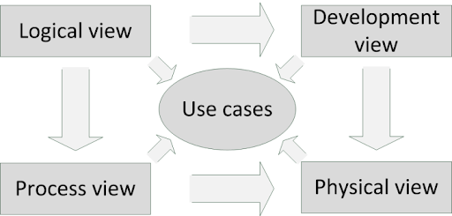
SnapFit

Slide 8
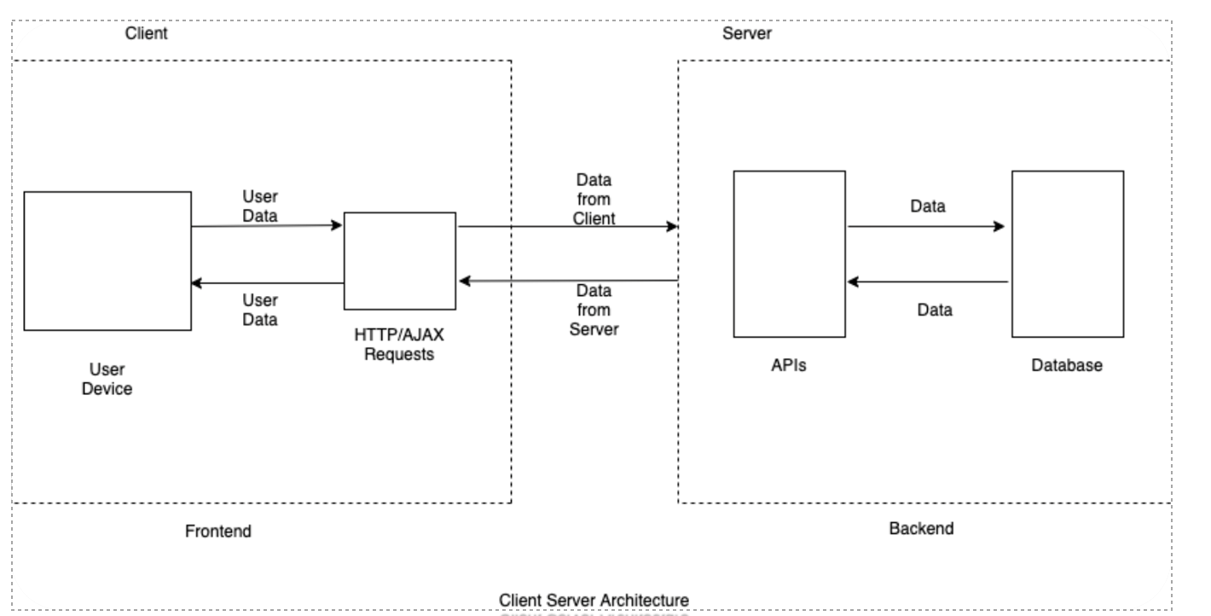
SnapFit

Slide 9
Logical View
Class diagram

Slide 10
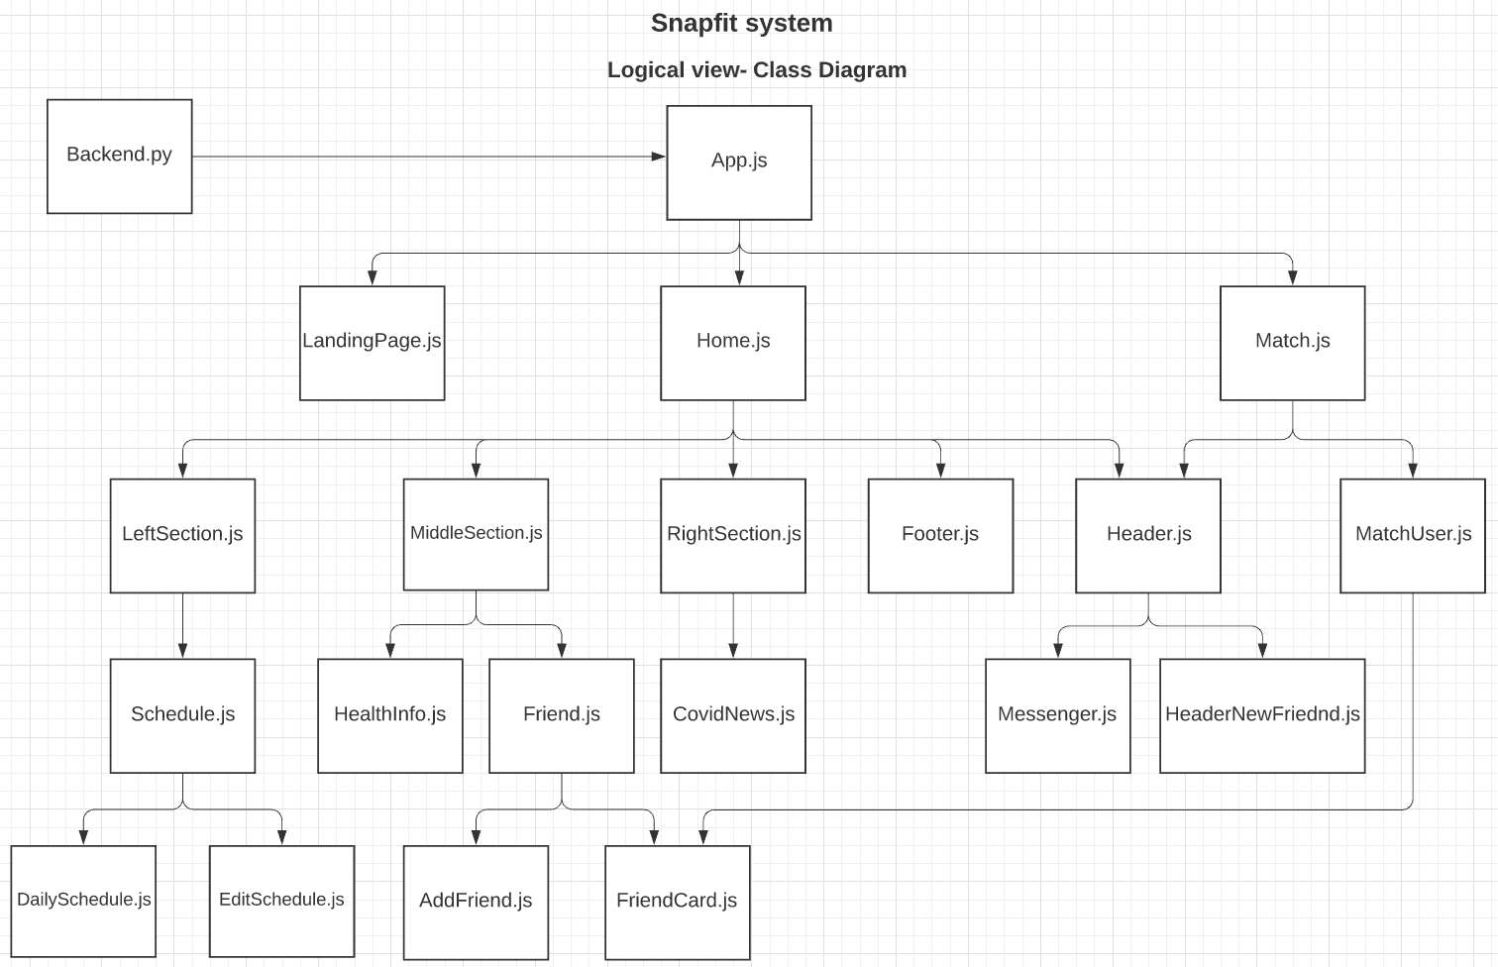
SnapFit

Slide 11
Process View
Sequence diagram

Slide 12
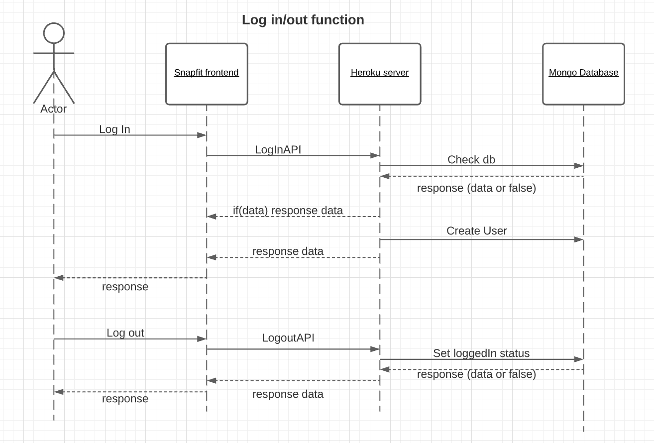
SnapFit

Slide 13
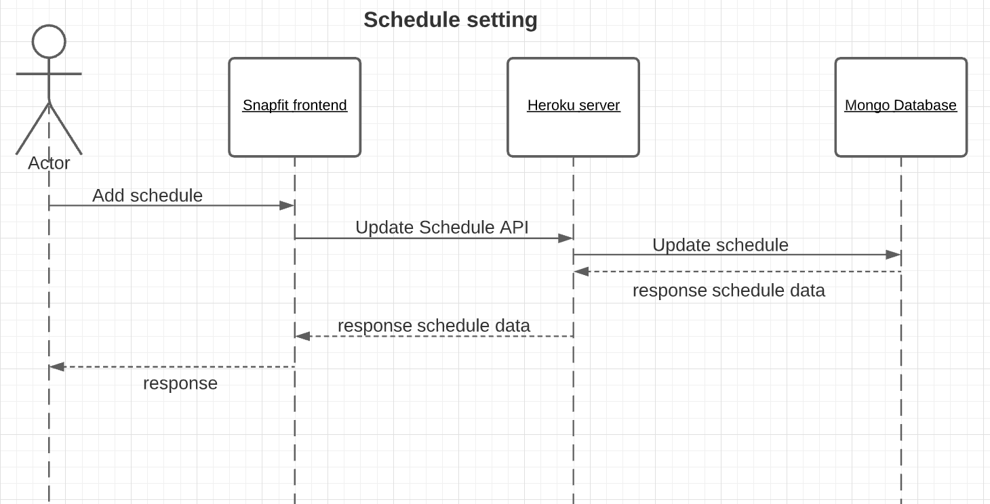
SnapFit

Slide 14
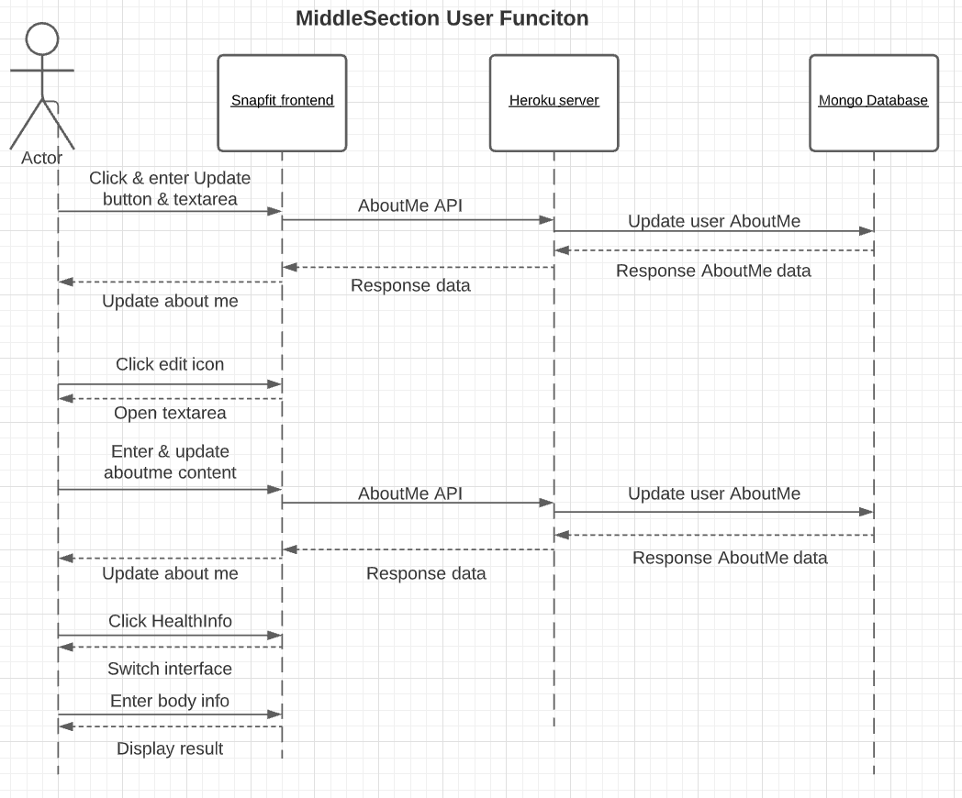
SnapFit

Slide 15
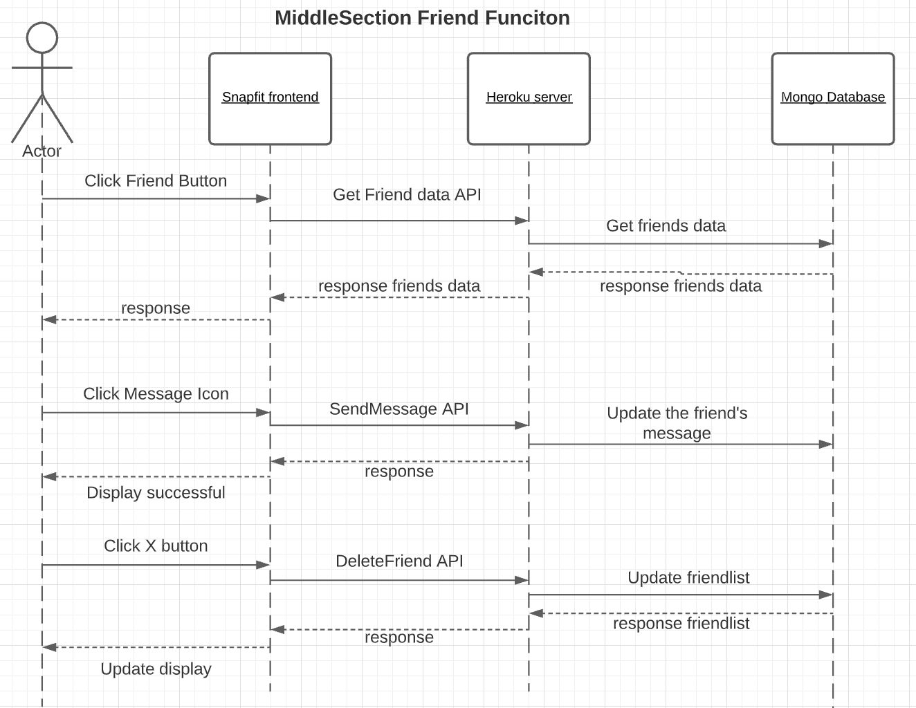
SnapFit

Slide 16
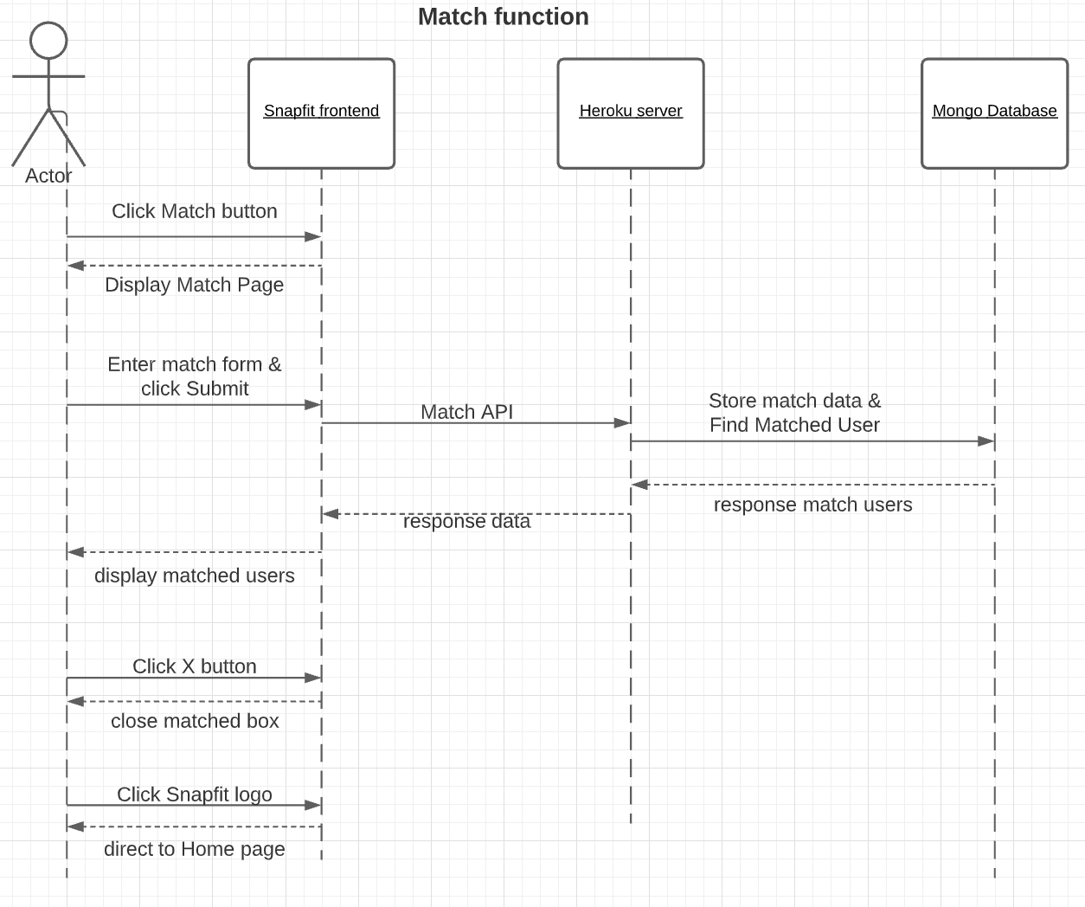
SnapFit

Slide 17
Development View
Component diagram

Slide 18
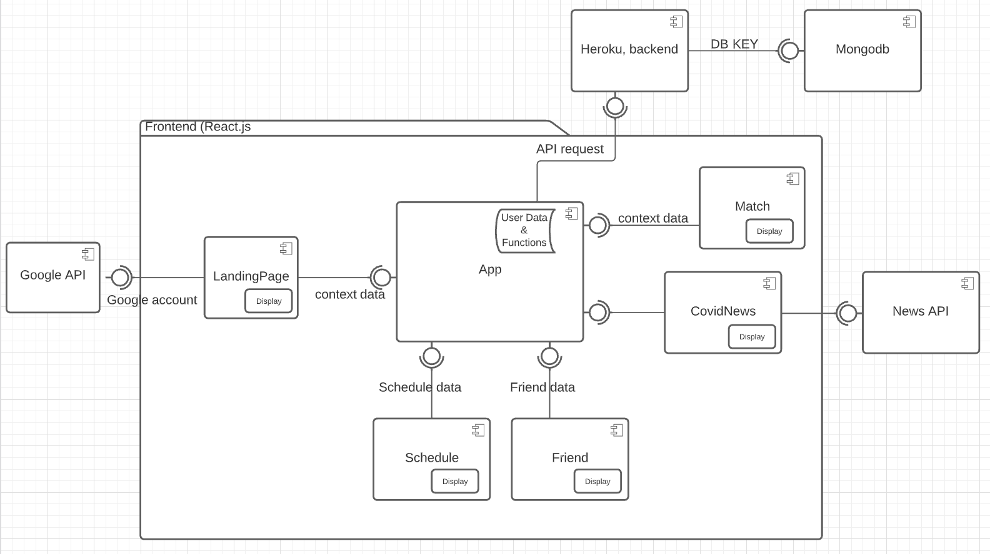
SnapFit

Slide 19
Physical View

Slide 20
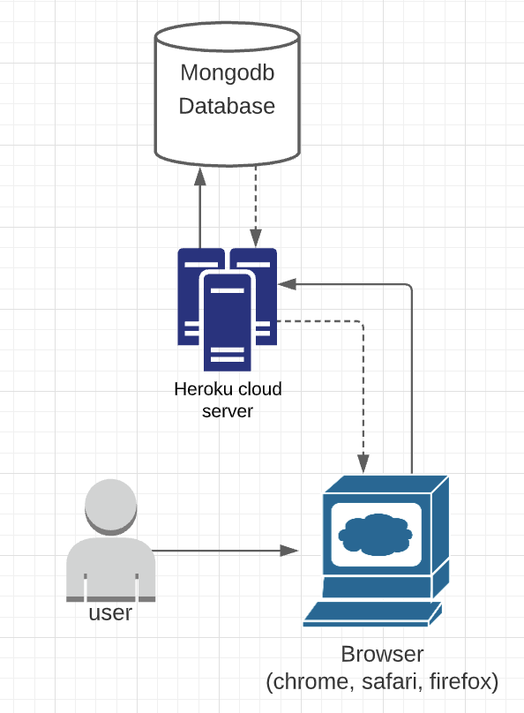
SnapFit

Slide 21
Use Case View

Slide 22
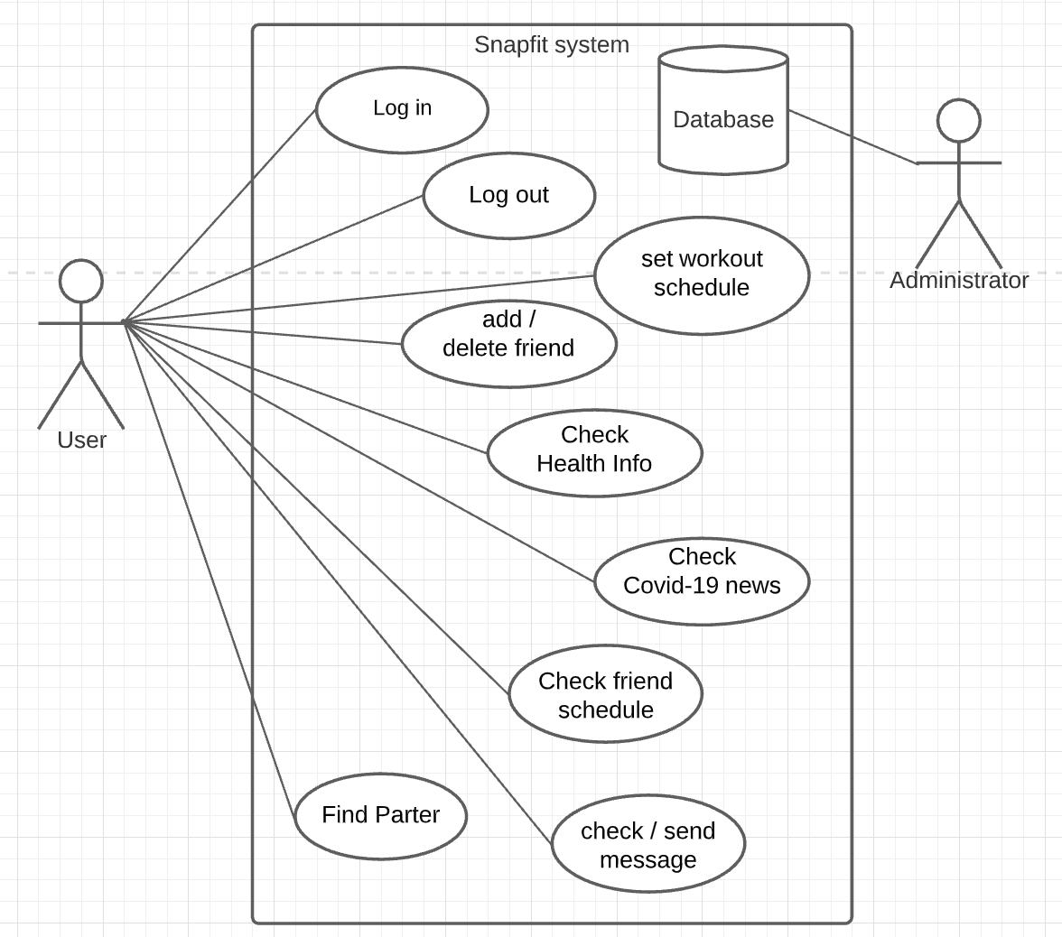
SnapFit

Slide 23
Development and
Testing

Slide 24
Process:
Agile Scrum
Product backlog created and maintained
Product backlog consists of 40 user stories
The user stories are split in 4 Sprints
Test Driven Development
Unit testing for backend
Tested APIs with Postman
SnapFit

Slide 25
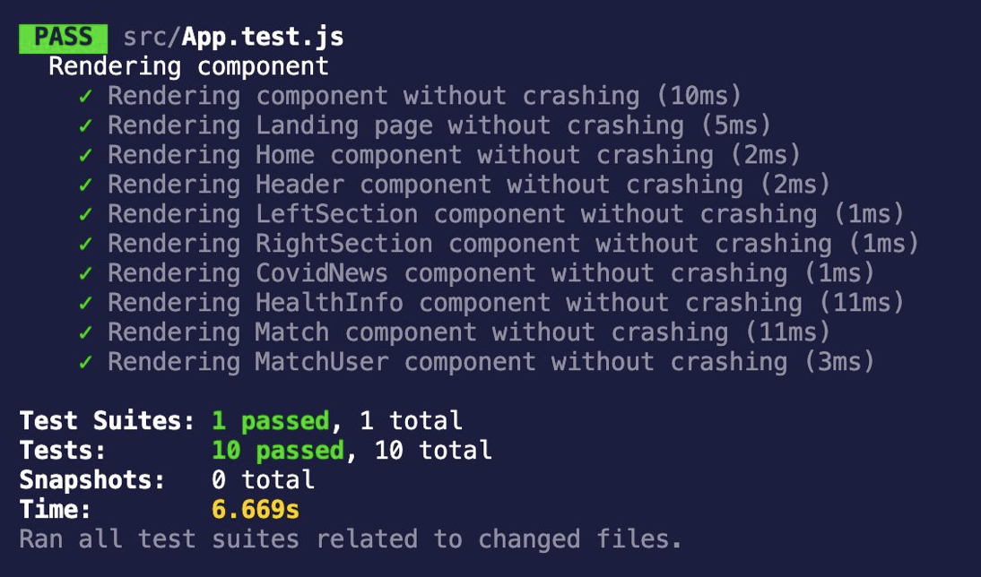
Frontend React App Jest test
SnapFit

Slide 26
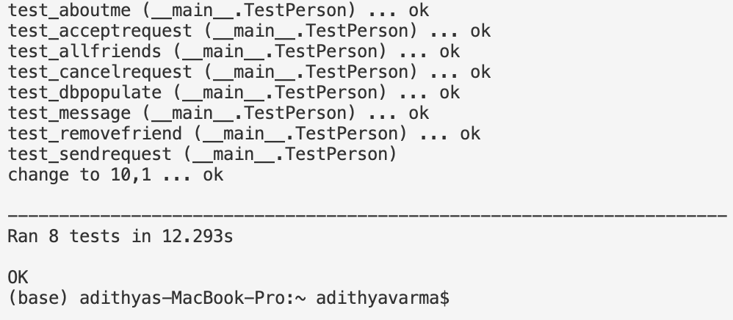
Backend Test using unit testing
SnapFit

Slide 27
Metric
Cyclomatic complexity
Maintainability Index

Slide 28
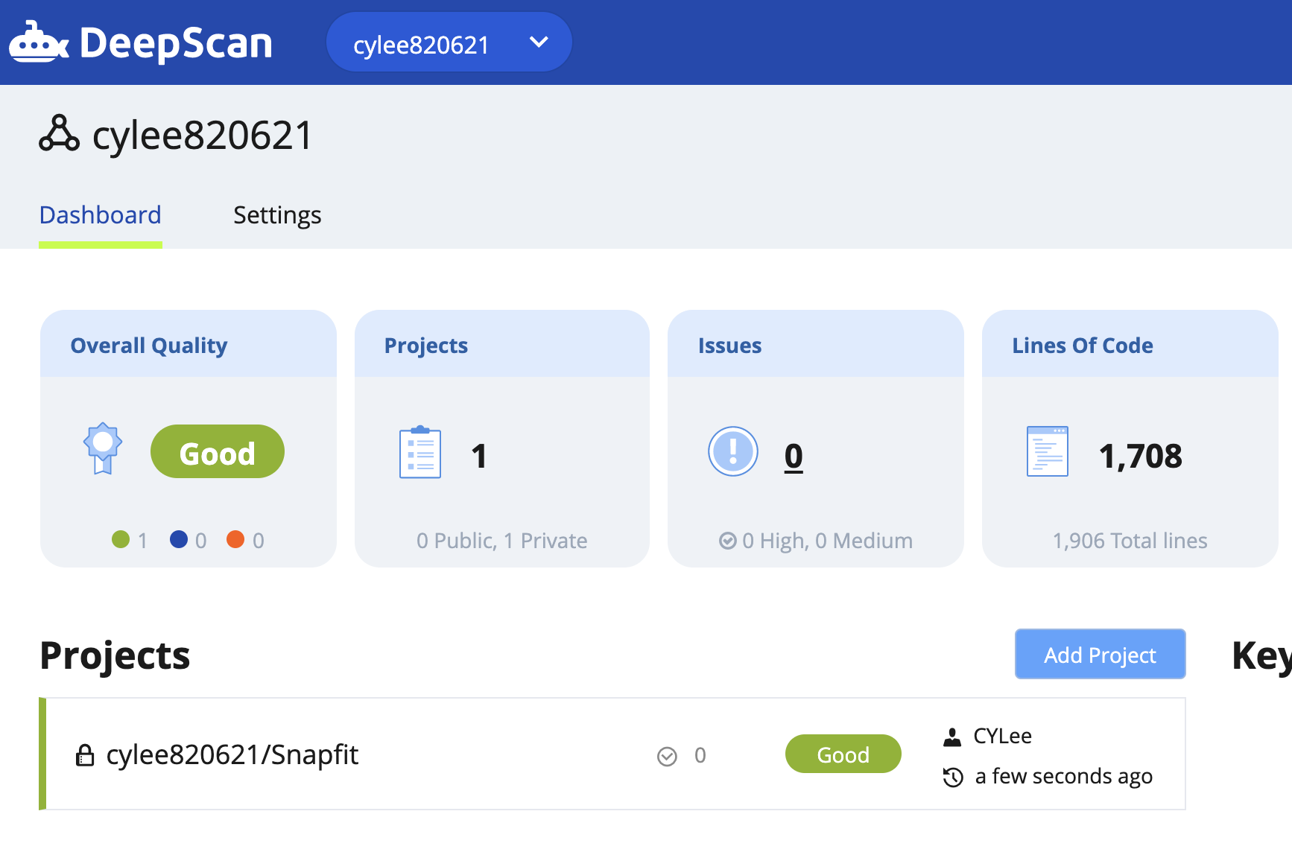
DeepScan- Third party static analysis tool for JavaScript
SnapFit

Slide 29
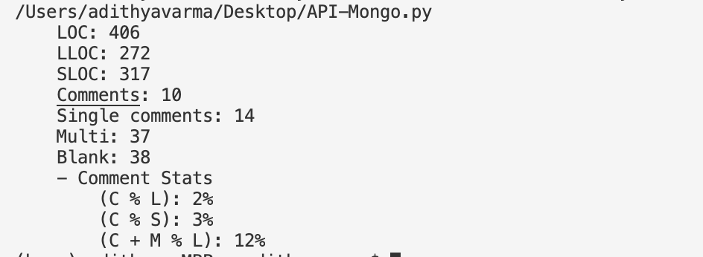
Calculating LOC, complexity and Maintainability using radon for backend
Maintainability Index
SnapFit

Slide 30
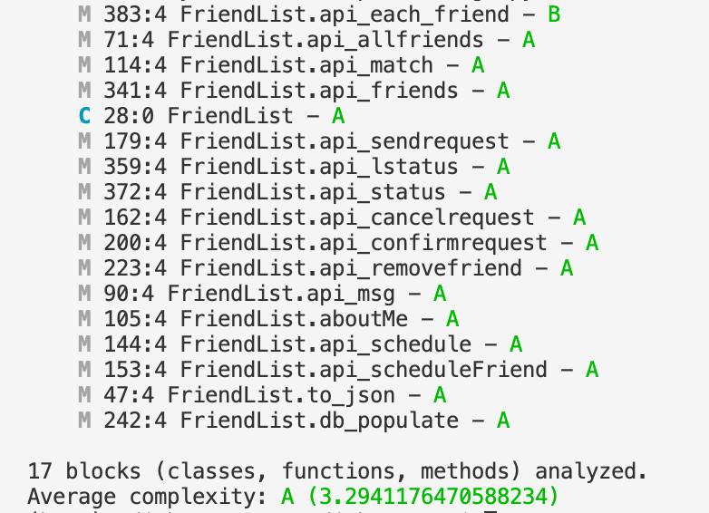
Cyclomatic Complexity
SnapFit

Slide 31
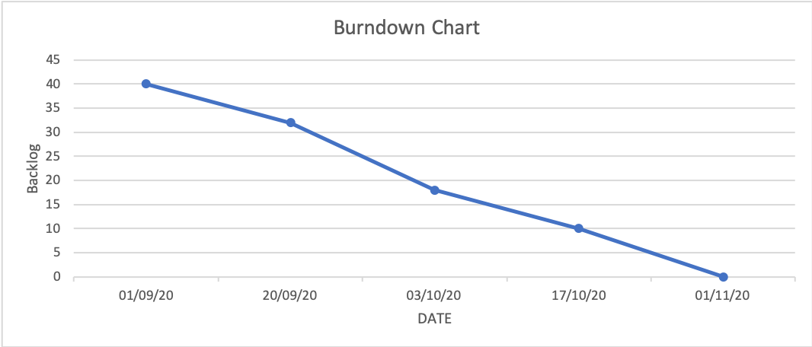
SnapFit

Slide 32
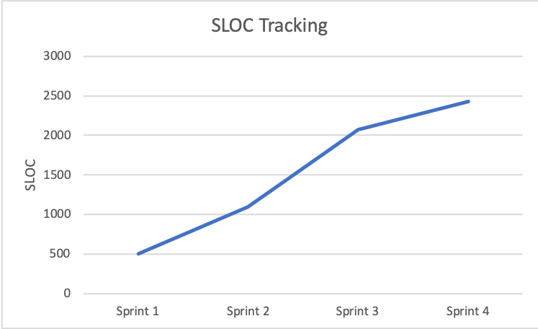
SnapFit

Slide 33
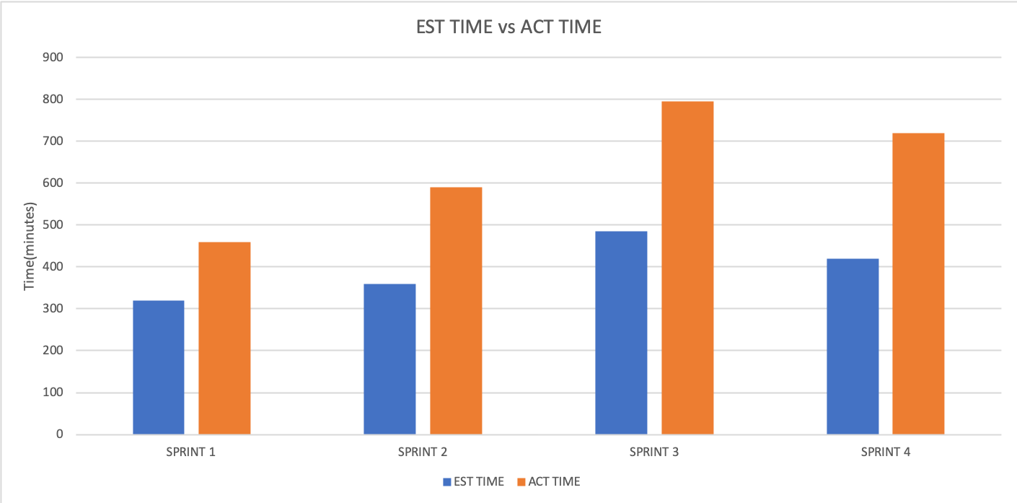
SnapFit

Slide 34
Future Work

Slide 35
Develop app for cross platform
Instant messaging between friends
Voice recognition for storing schedule
Enable application for smartwatches for easy match and messaging.
Use AI/ML to predict user schedule with previous data
SnapFit

Slide 36
Post Mortem
What would you do differently?
What would you do the same?

Slide 37
What would you do differently?
Create a well designed layout before implementing the backend
Break complex user stories into smaller simpler user stories
Develop with cross-platform adaptability in mind
What would you do the same?
Continue following the Agile Scrum process with short sprints
Continue using the same tools and technologies
Pair Programming and Test driven development
SnapFit

Slide 38
Code Repository

Slide 39
Frontend server
Github repository: https://github.com/cylee820621/Snapfit
Make sure JavaScript is in your development environment
Open folder with your IDE (Vscode)
Enter "npm install" in terminal to install all the packages.
Enter "npm start" in terminal to run the App.js file
Go to Browser, enter http://localhost:3000/ to the URL
Backend Server
https://snapfit-lutein.herokuapp.com/
SnapFit

Slide 40
About the class

Slide 41
What was the most valuable?
Architecture review
Code review
What was the least valuable?
Having Demos and Code review a week apart
What would you keep?
Code review and demos
What would you change?
More detailed architecture review
Introduce most recent technologies
Having Demo and Code review on the same day
SnapFit

Slide 42
THANK YOU

